Slide 1



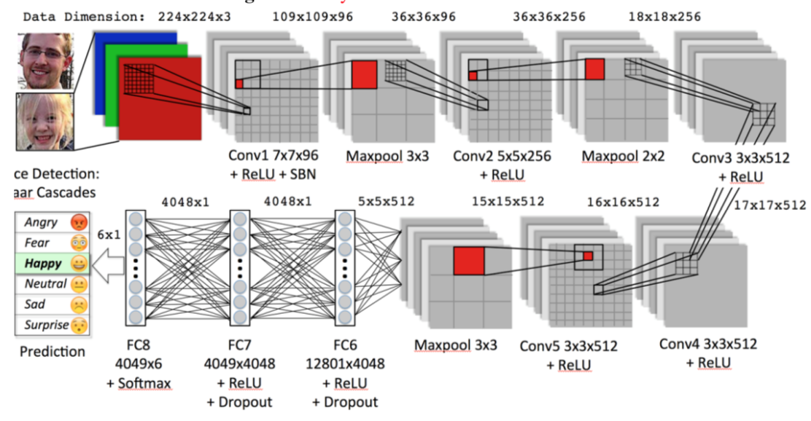
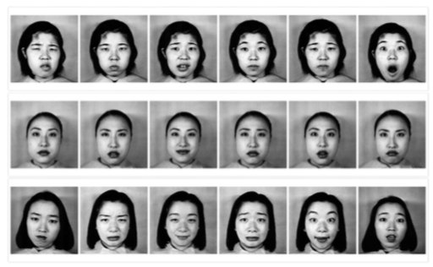
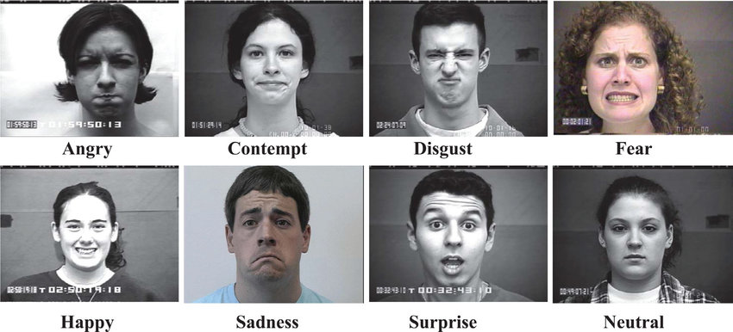
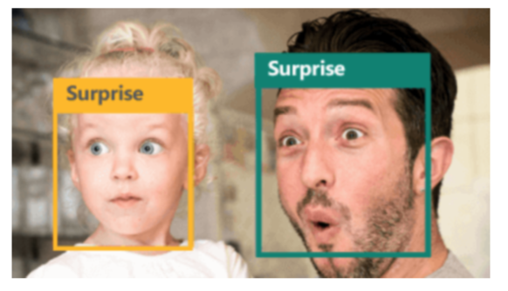
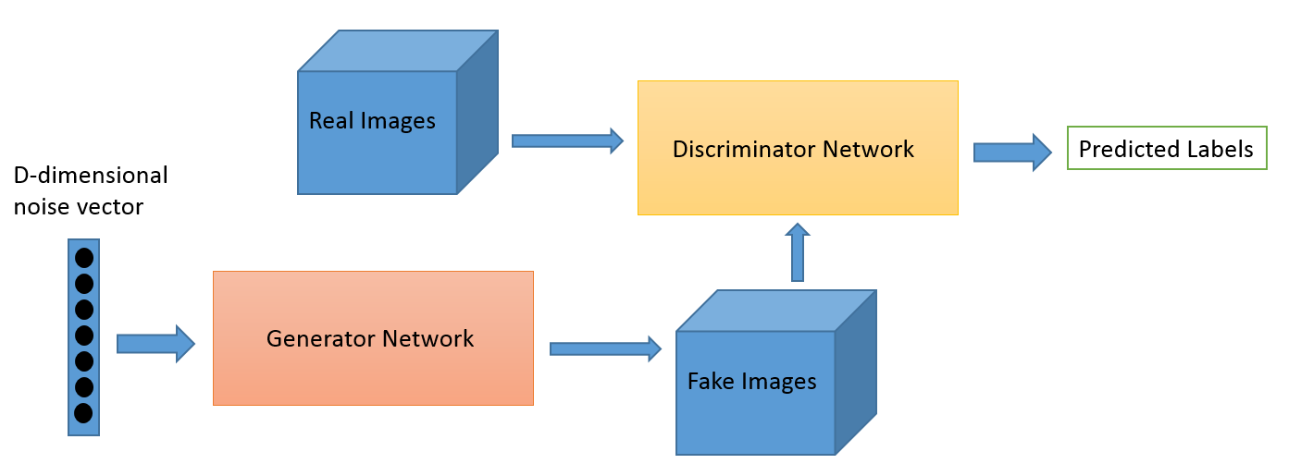
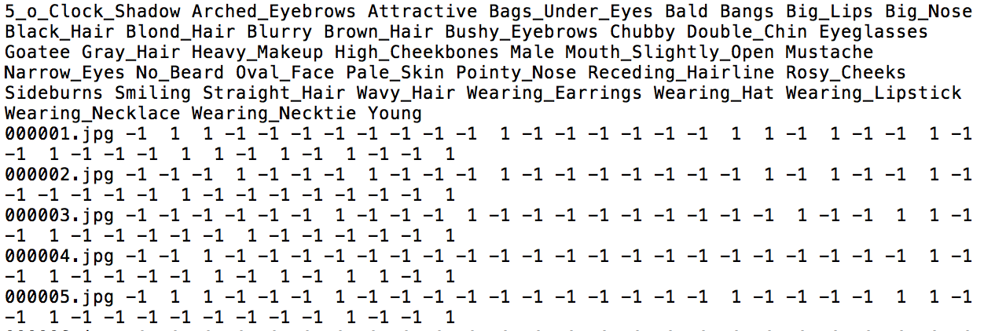
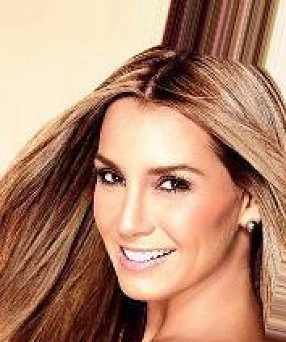
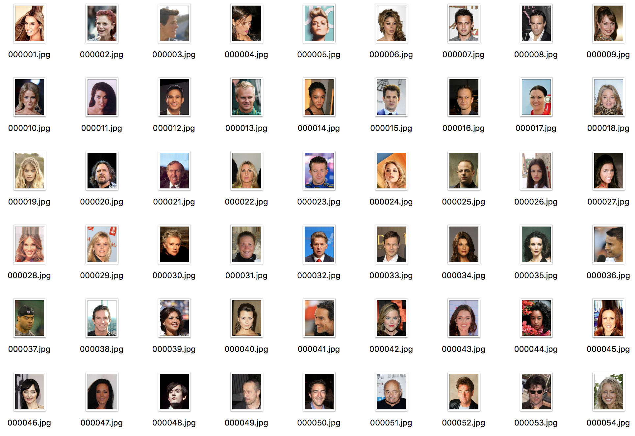
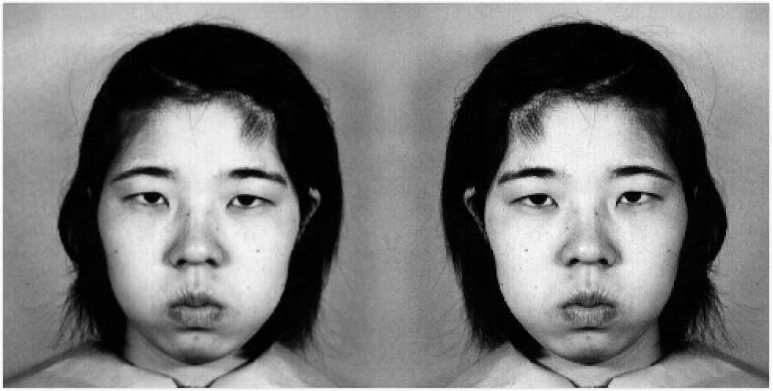
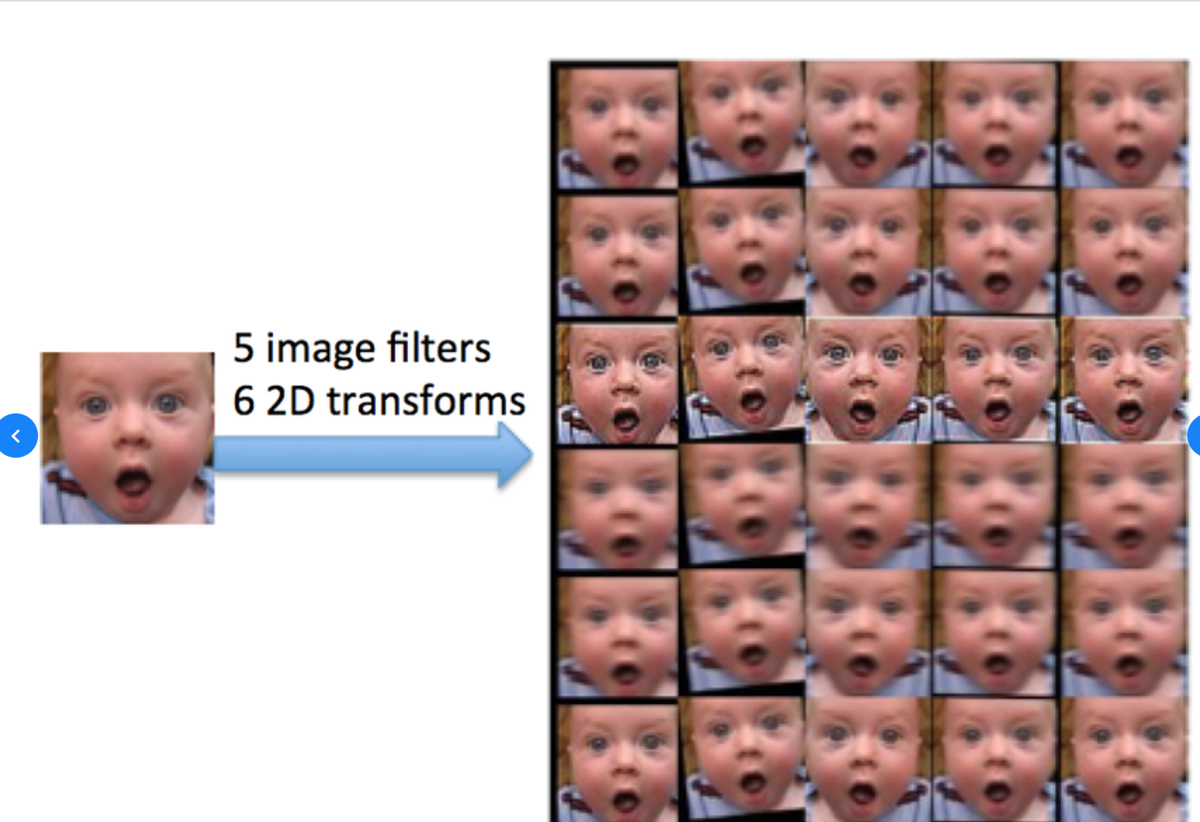
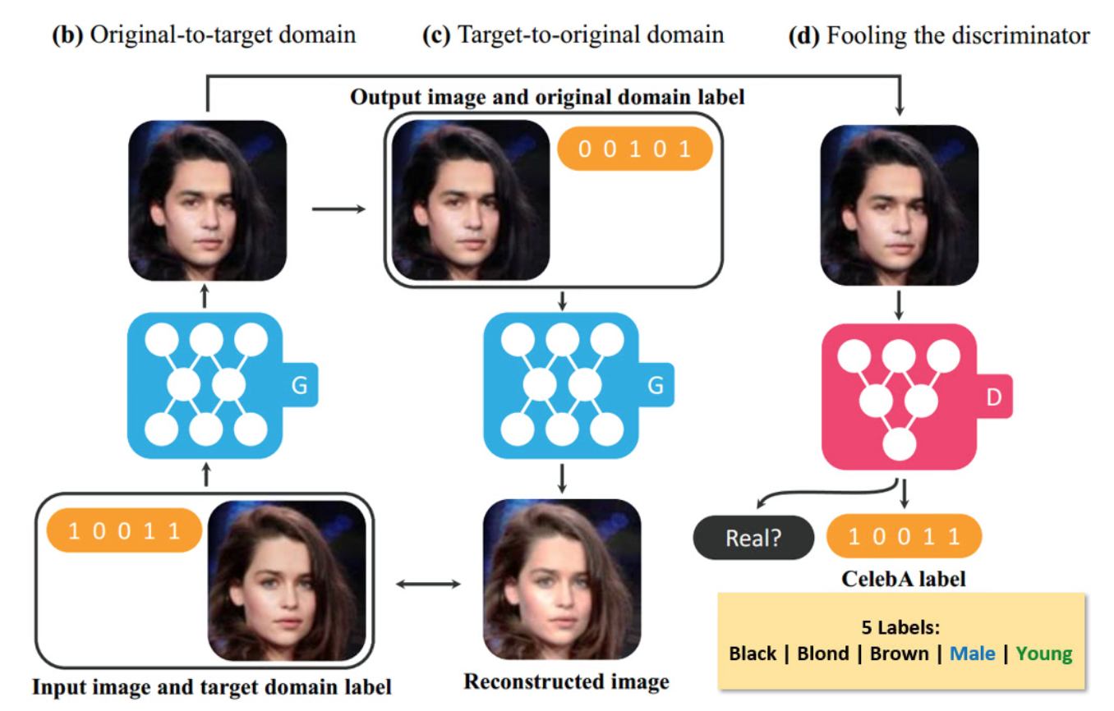
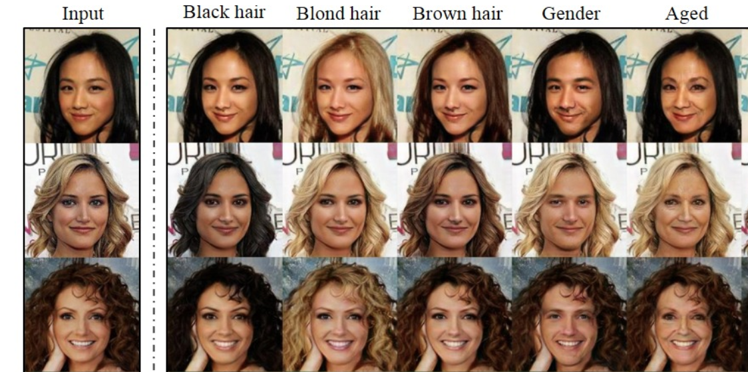
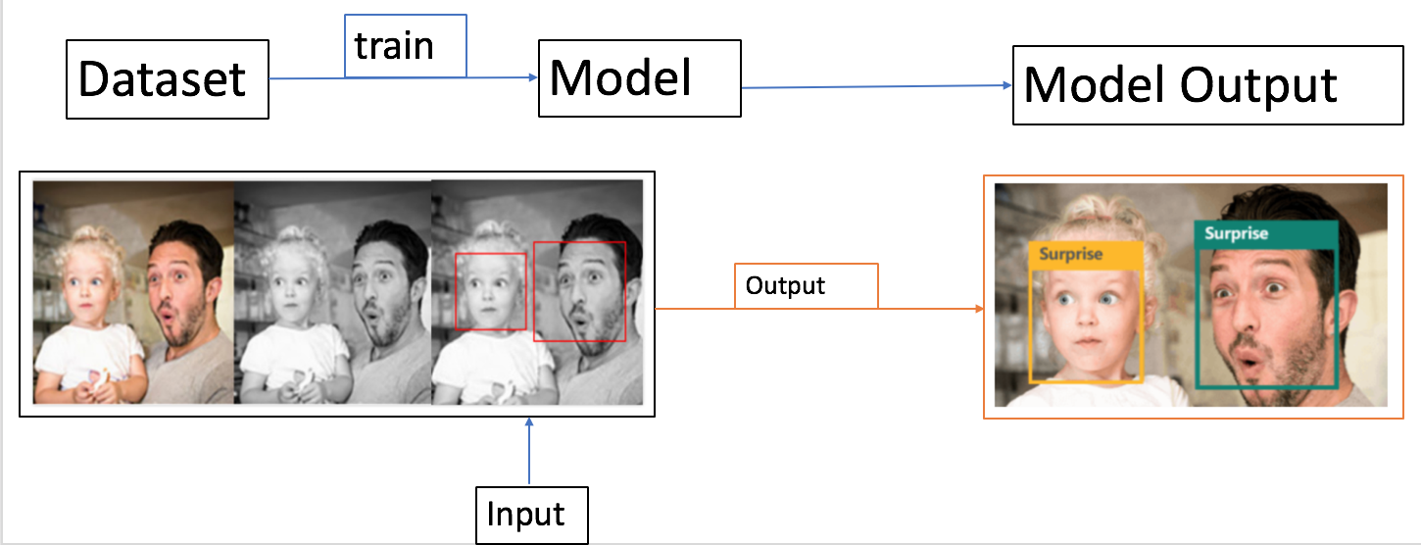
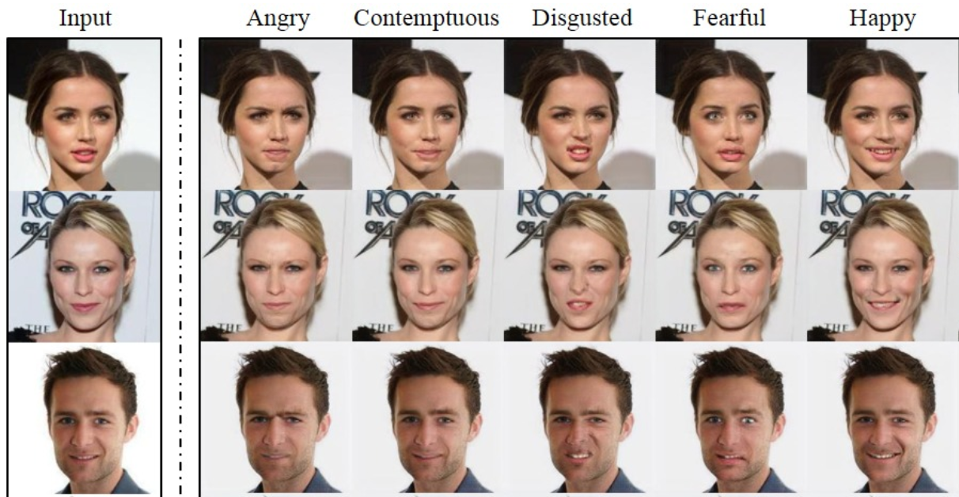
Image Processing and Multi-domain Translation
Martin Takáč , Judy Lu, Xi He, Shihwei Wang
Introduction
Data Preparation
Model Architecture
Emotions Detection
To train the neural network model, we use two different datasets: the extended Cohn-Kanade dataset (CK+) and the Japanese Female Facial Expression (JAFFE) database.
Figure 1 (a) Japanese Female Facial Expression (JAFFE) database (b) Cohn-Kanade dataset (CK+)
StarGAN
To do facial attribute translation, train StarGAN on dataset CelebA (200,000 images, 40 facial binary attributes). To do facial emotion translation, train StarGAN on the same image datasets (7 types of emotions) as emotions detection.
Figure 2 (a) CelebA dataset attributes labels (b) CelebA image
Image Processing: Emotions Detection
Datasets
Emotions Detection: Convolutional Neural Network
Figure 4 CNN
StarGAN
We have developed a convolutional neural network (CNN) to classify human facial emotions and accomplish real time facial emotion recognition. We use transfer learning on the fully- connected layers of an existing convolutional neural network which was trained for human emotion classification. A variety of datasets, as well as our own unique image dataset, is used to train the model. So far, an overall training accuracy of 90% is achieved.
StarGAN: Unified Generative Adversarial Networks for Multi-Domain Image-to-Image Translation
StarGAN's model takes both image and domain information as inputs and learns to translate the input image into the corresponding domain flexibly.
In this project, we proposed StarGAN to perform image-to-image translations for multiple domains using only a single model. We are working on facial attribute and facial emotion transfer.
Data Augmentation
Facial attribute translation
Figure 3 Procedures: data preparation, tuned model, train model, apply
Procedures
Future Works
Facial emotion translation
“Don’t forget to smile” 😄
Combine emotions detector and generator to develop a model to translate all facial emotions to smile.
References
[1] “Coding facial expressions with gabor wavelets,” in Automatic Face and Gesture Recognition, 1998. Proceedings. Third IEEE In- ternational Conference on, pp. 200–205, Apr 1998.
[2] Computer Vision and Pattern Recognition
[3] Computer Vision and Pattern Recognition Workshops (CVPRW), 2010 IEEE Computer Society Confer- ence on, pp. 94–101, June 2010

